Slide 1
Servlets

Slide 2
Servers
A server is a computer that responds to requests from a client
  Typical requests: provide a web page, upload or download a file, send email
A server is also the software that responds to these requests; a client could be the browser or other software making these requests
Typically, your little computer is the client, and someone else’s big computer is the server
  However, any computer can be a server
  It is not unusual to have server software and client software running on the same computer

Slide 3
Apache
Apache is a very popular server
  66% of the web sites on the Internet use Apache
Apache is:
  Full-featured and extensible
  Efficient
  Robust
  Secure (at least, more secure than other servers)
  Up to date with current standards
  Open source
  Free

Slide 4
Ports
A port is a connection between a server and a client
  Ports are identified by positive integers
  A port is a software notion, not a hardware notion, so there may be very many of them
A service is associated with a specific port
  Typical port numbers:
    21—FTP, File Transfer Protocol
    22—SSH, Secure Shell
    25—SMTP, Simple Mail Transfer Protocol
    53—DNS, Domain Name Service
    80—HTTP, Hypertext Transfer Protocol
    8080—HTTP (used for testing HTTP)
    7648, 7649—CU-SeeMe(Internet videoconferencing client)
    27960—Quake III
These are the ports of most interest to us

Slide 5
Ports II
Amrita Web page is:
http://www.engineering.amrita.edu/~it
But it is also:
http://www.engineering.amrita.edu:80/~it
The http: at the beginning signifies a particular protocol (communication language), the Hypertext Transfer Protocol
The :80 specifies a port
By default, the Web server listens to port 80
  The Web server could listen to any port it chooses
  This could lead to problems if the port was in use by some other server
  For testing servlets, we typically have the server listen to port 8080
In the second URL above, we explicitly sent our request to port 80
  If we had sent it to some other port, say, 99, our request would either go unheard, or would (probably) not be understood

Slide 6
Static Web Page
User enters URL
HTTP Request send to web server
Web Server maps request to specific file
File returned as HTTP Response
HTTP header indicates type of content
MIME(Multipurpose Internet Mail Extension) is used here

Slide 7
Dynamic Web Page
Eg: Online Book Store
Early days – Server constructs webpage dynamically – Separate process created to handle each client request
Communicates with Web Server via an Interface called CGI
Languages used to build CGI programs – C,C++,PERL

Slide 8
Server-side Programming
The combination of
  HTML
  JavaScript
  DOM
  is sometimes referred to as Dynamic HTML (DHTML)
Web pages that include scripting are often called dynamic pages (vs. static)

Slide 9
Server-side Programming
Similarly, web server response can be static or dynamic
  Static: HTML document is retrieved from the file system and returned to the client
  Dynamic: HTML document is generated by a program in response to an HTTP request
Java servlets are one technology for producing dynamic server responses
  Servlet is a Java class instantiated by the server to produce a dynamic response

Slide 10
Problems with CGI
Serious Performance problems
Expensive in terms of memory and processor resources
Expensive to open and close database connections
CGI is not platform-independent
Hence Servlets were introduced

Slide 11
Definitions
A servlet is a Java class that can be loaded dynamically into and run by a special web server.
This servlet-aware web server, is known as servlet container.
Servlets interact with clients via a request-response model based on HTTP.
Therefore, a servlet container must support HTTP as the protocol for client requests and server responses.
A servlet container also can support similar protocols such as HTTPS (HTTP over SSL) for secure transactions.

Slide 12
Servlets
A servlet is any class that implements the javax.servlet.Servlet interface
  In practice, most servlets extend the javax.servlet.http.HttpServlet class
  Some servlets extend javax.servlet.GenericServlet instead
Servlets, like applets, usually lack a main method, but must implement or override certain other methods

Slide 13
Servlets vs. CGI scripts
Advantages:
  Running a servlet doesn’t require creating a separate process each time
  A servlet stays in memory, so it doesn’t have to be reloaded each time
  There is only one instance handling multiple requests, not a separate instance for every request
  Untrusted servlets can be run in a “sandbox”
Disadvantage:
  Less choice of languages (CGI scripts can be in any language)

Slide 14
Servlets vs. CGI
Perl 1
A Servlet does not run in a separate process.
A Servlet stays in memory between requests.
A CGI program needs to be loaded and started for each CGI request.
There is only a single instance of a servlet which answers all requests concurrently.
Browser 1
Web
Server
Perl 2
Browser 2
Browser N
Perl N
Servlet
Browser 1
Web
Server
Browser 2
Browser N

Slide 15
What can you build with Servlets?
Search Engines
E-Commerce Applications
Shopping Carts
Product Catalogs
Intranet Applications
Groupware Applications:
  bulletin boards
  file sharing

Slide 16
Servlet Container Architecture
HTTP Request
Servlet
Container
Servlet
Browser
HTTP
Server
HTTP Response
Static
Content

Slide 17
How Servlets Work
is servlet
loaded?
Receive
Request
No
Yes
is servlet
current?
No
Load Servlet
Yes
Send
Response
Process Request

Slide 18
Servlets
A servlet is like an applet, but on the server side
Client sends a request to server
Server starts a servlet
server
client
Servlet computes a result for server and does not quit
client
Server returns response to client
servlet
Another client sends a request
Server calls the servlet again
Etc.

Slide 19
Life Cycle of a Servlet
INIT()
SERVICE()
DESTROY()

Slide 20
Life Cycle
A servlet is accessed through a URL, just as if it were a file or a CGI program.
When a request for a particular servlet is received, the Java Server invokes the servlet as a separate thread of execution.
Once started, it can receive environment information as well as client query information similar to that provided through the CGI. It processes the request and returns its data, formatted as HTML, to be included in the body of the HTTP response generated by the Java Server.
The servlet is then destroyed by the Java Server.

Slide 21
Servlet methods
After being loaded, servlet life cycle includes three methods:
init() - server activates servlet
  perform potentially costly (usually, I/O intensive) setup only once, rather than once per request.
    initializing sessions with other network services or
    getting access to their persistent data (stored in a database or file).
service() - servlet handles many requests. Each client request generates one service() call.
  requests may be concurrent; allows servlets to coordinate activities among many clients.
  Class-static state may be used to share data between requests.
destroy() - requests processed until servlet is explicitly shut down by the web server, by calling the destroy method.
  Servlet's class may become eligible for garbage collection.

Slide 22
STEPS INVOLVED
Step I – User enters URL. Browser generates HTTP request. Request sent to server
Step II – HTTP request received by web server. Server maps request to servlet. Servlet is dynamically retrieved and loaded into address space of server
Step III – Server invokes init() method. Invoked only when servlet loaded into memory.

Slide 23
STEPS INVOLVED(cont..)
Step IV – Server invokes service() method. This processes HTTP request. Also formulates a HTTP response
Remains in the server’s address space to process any other requests from clients
Called for each HTTP Request
Step V – Destroy() method releases all resources(file handles). Memory allocated for the servlet and its objects can then be garbage collected

Slide 24
Using TOMCAT for Servlet development
Download Tomcat 6.0
Has class libraries, documentation and run-time support needed to create and test servlets
By default saved in C:\Program Files\Apache Tomcat 6.0\
To start Tomcat run startup.bat from C:\Program Files\Apache Tomcat 6.0\bin
Test servlets and stop Tomcat by executing shutdown.bat
Compile the servlets using javac fname.java –classpath “C:\Program Files\Apache Tomcat 6.0\common\lib\servlet.jar
Copy the class file into the directory C:\Program Files\Apache Tomcat 6.0\webapps\egs\WEB-INF\classes

Slide 25
Tomcat
Tomcat is the Servlet Engine than handles servlet requests for Apache
  Tomcat is a “helper application” for Apache
  It’s best to think of Tomcat as a “servlet container”
Apache can handle many types of web services
  Apache can be installed without Tomcat
  Tomcat can be installed without Apache
It’s easier to install Tomcat standalone than as part of Apache
  By itself, Tomcat can handle web pages, servlets, and JSP
Apache and Tomcat are open source (and therefore free)

Slide 26
A Simple Servlet
Create and compile the servlet source code
Start TOMCAT
Start a Web Browser and request the Servlet

Slide 27
Step I
Create and compile the servlet source code – Helloservlet is a subclass of GenericServlet
GenericServlet handles all requests and responses
Service method() is overridden
ServletRequest – Reads data provided via client request
ServletResponse – Formulates a response for the client

Slide 28
public class SimpleServlet extends HttpServlet {
/*** Handle the HTTP GET method by building a simple web page.*/
public void doGet (HttpServletRequest request, HttpServletResponse response)
throws ServletException, IOException {
PrintWriter out;
// set content type and other response header fields first
response.setContentType("text/html");
// then write the data of the response
out = response.getWriter();
out.println("<HTML><HEAD><TITLE>");
out.println(title);
out.println("</TITLE></HEAD><BODY>");
out.println("<H1> Simple Servlet Output </H1>");
out.println("<P>This is output from SimpleServlet.");
out.println("</BODY></HTML>");
out.close();
}
}

Slide 29
Step II
Start TOMCAT by executing startup.bat from C:\Program Files\Apache Tomcat 6.0\bin directory

Slide 30
Step III
Start Web browser and request the Servlet – Enter URL as:
http://localhost:8080/examples/servlet/HelloServlet
or
http://127.0.0.1:8080/examples/servlet/HelloServlet

Slide 31
Class Hierarchy
Servlets are implemented using the Java Servlet API.
All servlets implement the Servlet interface.
  extend either the GenericServlet class, which implements the Servlet interface, or its subclass, HttpServlet.
2 packages: javax.servlet and javax.servlet.http.
    not part of the core Java framework, so do not begin with java. part of the Standard Java Extension API, begin with the keyword javax.
Create a servlet as an extension of HttpServlet (which is a subclass of GenericServlet, which implements Servlet interface).

Slide 32
Important servlet methods, I
When a servlet is first started up, its init(ServletConfig config) method is called
  init should perform any necessary initializations
  init is called only once, and does not need to be thread-safe
Every servlet request results in a call to
service(ServletRequest request, ServletResponse response)
  service calls another method depending on the type of service requested
  Usually you would override the called methods of interest, not service itself
  service handles multiple simultaneous requests, so it and the methods it calls must be thread safe
When the servlet is shut down, destroy() is called
  destroy is called only once, but must be thread safe (because other threads may still be running)

Slide 33
HTTP requests
When a request is submitted from a Web page, it is almost always a GET or a POST request
The HTTP <form> tag has an attribute action, whose value can be "get" or "post"
The "get" action results in the form information being put after a ? in the URL
  Example:
  http://www.google.com/search?hl=en&ie=UTF-8&oe=UTF-8&q=servlets
  The & separates the various parameters
  Only a limited amount of information can be sent this way
"post" can send large amounts of information

Slide 34
Important servlet methods, II
The service method dispatches the following kinds of requests: DELETE, GET, HEAD, OPTIONS, POST, PUT, and TRACE
  A GET request is dispatched to the doGet(HttpServletRequest request, HttpServletResponse response) method
  A POST request is dispatched to the doPost(HttpServletRequest request, HttpServletResponse response) method
  These are the two methods you will usually override
  doGet and doPost typically do the same thing, so usually you do the real work in one, and have the other just call it
  public void doGet(HttpServletRequest request,
  HttpServletResponse response) {
  doPost(request, response);
  }

Slide 35
A “Hello World” servlet
(from the Tomcat installation documentation)
public class HelloServlet extends HttpServlet {
public void doGet(HttpServletRequest request,
HttpServletResponse response)
throws ServletException, IOException {
response.setContentType("text/html");
PrintWriter out = response.getWriter();
out.println("<HTML>\n" +
"<HEAD><TITLE>Hello</TITLE></HEAD>\n" +
"<BODY BGCOLOR=\"#FDF5E6\">\n" +
"<H1>Hello World</H1>\n" +
"</BODY></HTML>");
}
}

Slide 36
The superclass
public class HelloServlet extends HttpServlet { }
Every class must extend GenericServlet or a subclass of GenericServlet
  GenericServlet is “protocol independent,” so you could write a servlet to process any protocol
  In practice, you almost always want to respond to an HTTP request, so you extend HttpServlet
A subclass of HttpServlet must override at least one method, usually one doGet, doPost, doPut, doDelete, init and destroy, or getServletInfo

Slide 37
The doGet method
public void doGet(HttpServletRequest request,HttpServletResponse response)
throws ServletException, IOException {
This method services a GET request
The method uses request to get the information that was sent to it
The method does not return a value; instead, it uses response to get an I/O stream, and outputs its response
Since the method does I/O, it can throw an IOException
Any other type of exception should be encapsulated as a ServletException
The doPost method works exactly the same way

Slide 38
Parameters to doGet
Input is from the HttpServletRequest parameter
  Our first example doesn’t get any input, so we’ll discuss this a bit later
Output is via the HttpServletResponse object, which we have named response
  I/O in Java is very flexible but also quite complex, so this object acts as an “assistant”

Slide 39
Using the HttpServletResponse
The second parameter to doGet (or doPost) is HttpServletResponse response
Everything sent via the Web has a “MIME type”
The first thing we must do with response is set the MIME type of our reply: response.setContentType("text/html");
  This tells the client to interpret the page as HTML
Because we will be outputting character data, we need a PrintWriter, handily provided for us by the getWriter method of response:
PrintWriter out = response.getWriter();
Now we’re ready to create the actual page to be returned

Slide 40
Using the PrintWriter
From here on, it’s just a matter of using our PrintWriter, named out, to produce the Web page
First we create a header string:
String docType =
"<!DOCTYPE HTML PUBLIC \"-//W3C//DTD HTML 4.0 " +
"Transitional//EN\">\n";
  This line is technically required by the HTML spec
  Browsers mostly don’t care, but HTML validators do care
Then use the println method of out one or more times
out.println(docType +
"<HTML>\n" +
"<HEAD> ... </BODY></HTML>");

Slide 41
Input to a servlet
A GET request supplies parameters in the form
URL ? name=value & name=value & name=value
  (Illegal spaces added to make it more legible)
  Actual spaces in the parameter values are encoded by + signs
  Other special characters are encoded in hex; for example, an ampersand is represented by %26
Parameter names can occur more than once, with different values
A POST request supplies parameters in the same syntax, only it is in the “body” section of the request and is therefore harder for the user to see

Slide 42
Getting the parameters
Input parameters are retrieved via messages to the HttpServletRequest object request
  Most of the interesting methods are inherited from the superinterface ServletRequest
public Enumeration getParameterNames()
  Returns an Enumeration of the parameter names
  If no parameters, returns an empty Enumeration
public String getParameter(String name)
  Returns the value of the parameter name as a String
  If the parameter doesn’t exist, returns null
  If name has multiple values, only the first is returned
public String[] getParameterValues(name)
  Returns an array of values of the parameter name
  If the parameter doesn’t exist, returns null

Slide 43
Example of input parameters
public void doGet(HttpServletRequest request,
HttpServletResponse response) {
... stuff omitted ...
out.println("<H1>Hello");
String names[] =
request.getParameterValues("name");
if (names != null)
for (int i = 0; i < names.length; i++)
out.println(" " + names[i]);
out.println("!");}

Slide 44
Servlets vs. Java Applications
Servlets do not have a main()
  The main() is in the server
  Entry point to servlet code is via call to a method (doGet() in the example)
Servlet interaction with end user is indirect via request/response object APIs
  Actual HTTP request/response processing is handled by the server
Primary servlet output is typically HTML

Slide 45
Running Servlets
Simple way to run a servlet (better later):
  Compile servlet (make sure that JWSDP libraries are on path)
  Copy .class file to shared/classes directory
  (Re)start the Tomcat web server
  If the class is named ServletHello, browse to
  http://localhost:8080/servlet/ServletHello

Slide 46
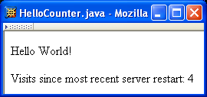
Dynamic Content

Slide 47
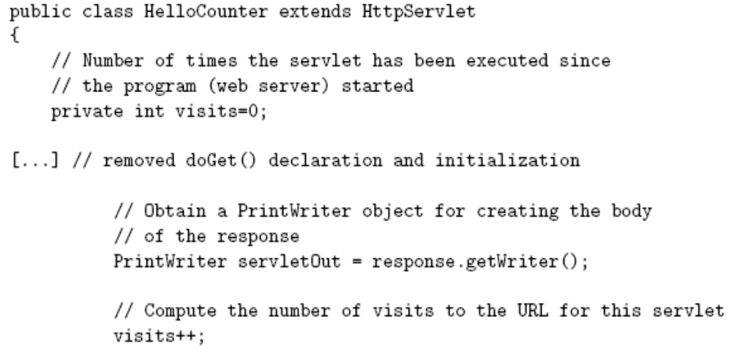
Dynamic Content

Slide 48
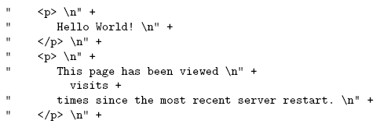
Dynamic Content

Slide 49
Dynamic Content
Potential problems:
  Assuming one instance of servlet on one server, but
    Many Web sites are distributed over multiple servers
    Even a single server can (not default) create multiple instances of a single servlet
  Even if the assumption is correct, this servlet does not handle concurrent accesses properly

Slide 50
Advantages of Servlets
Executes within address space of Web Server – Performance is better
Written in Java - Platform Independent – No need for recompilation
Resources on server machine are protected by the Java security manager
Offers full functionality of Java class libraries – can communicate with applets, DB or other software using sockets or RMI mechanism

Slide 51
Benefits of Java Servlets
Performance
  The performance of servlets is superior to CGI because there is no process creation for each client request.
  Each request is handled by the servlet container process.
  After a servlet has completed processing a request, it stays resident in memory, waiting for another request.
Portability
  Like other Java technologies, servlet applications are portable.
Rapid development cycle
  As a Java technology, servlets have access to the rich Java library that will help speed up the development process.
Robustness
  Servlets are managed by the Java Virtual Machine.
  Don't need to worry about memory leak or garbage collection, which helps you write robust applications.
Widespread acceptance
  Java is a widely accepted technology.

